Slide 1
STAT 542 Midterm Project Presentation
Group 8:
Group Member: Yefan Li, Jue Li, Yijin Wang, Xiao Ma, Wenxuan Gu, Pengru Lyu, Ziyi Xue, Yanqing Li

Slide 2
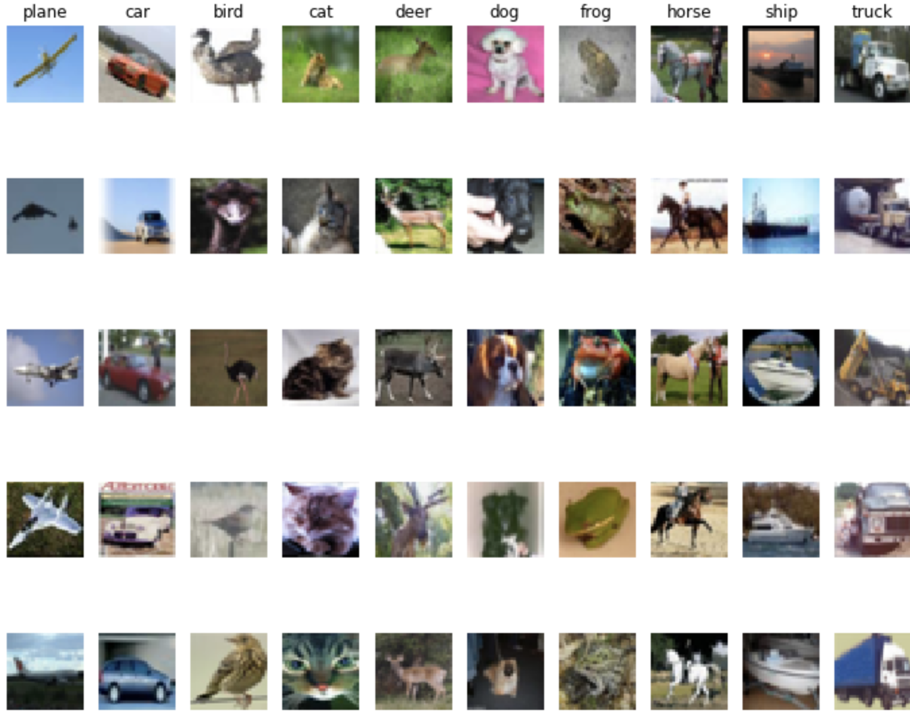
Dataset
The CIFAR-10 dataset consists of 60000 32x32 colour images in 10 classes, with 6000 images per class. There are 50000 training images and 10000 test images.
The dataset is divided into five training batches and one test batch, each with 10,000 images. The test batch contains exactly 10,000 randomly-selected images from each class.
Yanqing Li

Slide 3
Support Vector Machines (SVM)
SVM is a set of supervised learning methods that find the hyperplanes to separate datasets.
Pros & Cons of SVM (with this dataset)：
Pros：effective in high dimensional spaces, by mapping input data with different kernels
Cons:
a. computationally intensive, especially we choose the k-fold CV method for turning parameters
b.highly affected by the choice of the kernel
Ziyi Xue

Slide 4
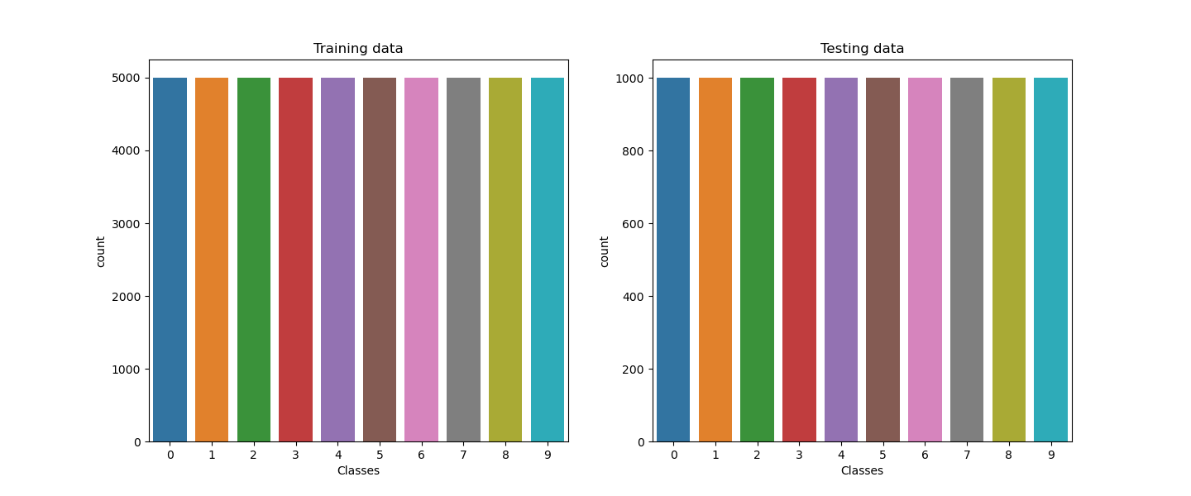
Preprocessing Data
Shape of the dataset：
a. Change 32 * 32*3 color image data into 1 Dimension
(potential problems caused by the really high dimensions)
b. Scale the pixel value in [0,1]
Balance of the data:
Ziyi Xue
Notes:
Before building the model, we process the 3 dimensional image data into one dimension and scale the pixel values.
The dimensional transformation process leads to a high dimension dataset. This would affect the model performance.
And also, we checked the balance of the data, and found each class has the same sample size, shown like the graphs for both training and testing dataset, which means the data is balanced.

Slide 5
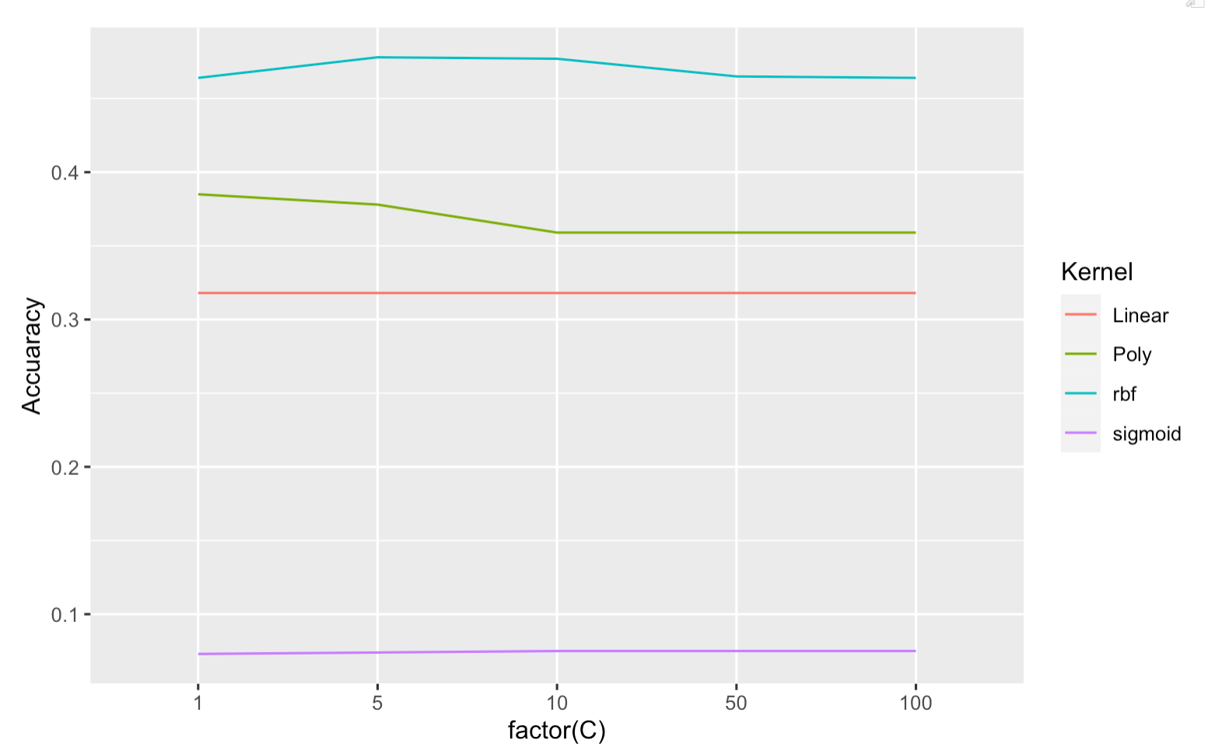
SVM Model Parameters & Selection
Our SVM model is based on tuning the kernels and the parameters c and gamma:
finalModel = SVC(C=1, gamma=`scale`, kernel='poly')
Parameters:
Regularization parameter (c) :
The strength of the regularization is inversely proportional to C. Must be strictly positive. The penalty is a squared l2 penalty.
gamma: determine the width of the kernel (useless for linear kernel)
Kernel: ‘linear’; ‘ poly’; ‘rdf’; ‘sigmoid’
Degree: Degree of the polynomial kernel function (‘poly’) and ignore by all other kernel.
Method:
Fixed gamma value, different C value (1, 5, 10, 50, 100)
Fixed C value, different gamma value (1e-2, 1e-3, 1e-4)
Jue Li
Notes:
For our svm method, we tried different parameters of C, gamma, and kernel types to evaluate their accuracy. We used 10,000 training data to test the models. Initially, we fixed the gamma value and varied the C value using different kernel types. We tested C values as 1, 5, 10, 50, and 100 and plotted the results, which are shown on the right side. Interestingly, we observed that the poly kernel and RBF kernel’s accuracy value performed well across different C values. And accuracy of poly is arround 0.36 to 0.39, rdf kernel model’s accuracy value is arround 0.46 to 0.48.
Next, we keep the C value fixed and tested different gamma values from 1e-2 (ten to the negative 2) ,to 1e-4. Surprisingly, we found that the accuracy value did not change significantly clear with different gamma values for the different kernel types. Therefore, we decided to focus on the poly and RBF kernels model with C=1 and a fixed gamma value.
Using these result, we trained the models on whole data and evaluated their accuracy. The poly kernel model and the RBF kernel model with default valu eof parameter C and parameter gamma
GridSearchCV() with cv = 5
tuned_parameters = [{'kernel': ['rbf'], 'gamma': [1e-2, 1e-3, 1e-4, 1e-5],
'C': [0.001, 0.10, 0.1, 10, 25, 50, 100, 1000]},
{'kernel': ['sigmoid'], 'gamma': [1e-2, 1e-3, 1e-4, 1e-5],
'C': [0.001, 0.10, 0.1, 10, 25, 50, 100, 1000] },{'kernel': ['linear'], 'C': [0.001, 0.10, 0.1, 10, 25, 50, 100, 1000]}]

Slide 6
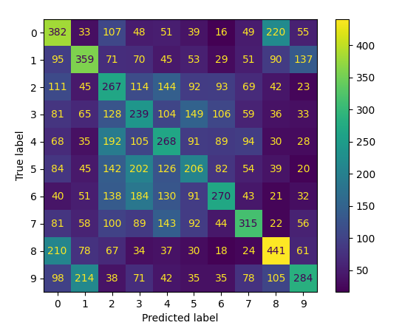
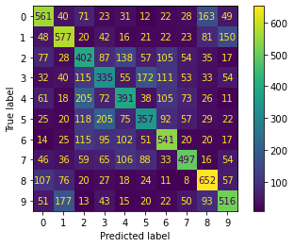
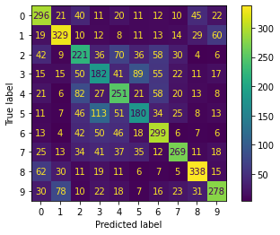

Results & Performance of SVM
Nonlinear (poly) without parameter tuning:
Accuracy: 52.86%
Runtime: 9747.61 s (~3hr)
Linear SVM with accuracy around 30.31 %
Nonlinear (rbf) with parameter tuning:
Accuracy: 48.29%
Runtime: 1283.28 s (~21.4 min)
10000 trained and test data
50000 trained data and 5000 test data
Yijin Wang
Notes:
We suppose to train the whole dataset which contain 50,000 data, but since the running time is so long, we have only successfully trained once whole dataset and tested the nonlinear SVM model with 5000 test data. This is the right most picture in this slide. In this case, we used polynomial as kernel and got the highest accuracy score – around 52.86%.
The left and middle two pictures are both with 10,000 trained and test data. We have about 30% accuracy for linear SVM model and around 48% accuracy for the nonlinear SVM model with parameter tuning, such as kernel = ‘rbf’, C = 5, gamma = ‘scale’. We have used different C {from range 1, 2, 5, 10}, different gamma value {from range 0.1, 0.01, 0.001}, and different kernel such as polynomial and Sigmoid. This is the best nonlinear result with parameter tuning we got so far.
You can see and compare the three confusion matrix pictures to have a sense on the accuracy level. Apparently, the nonlinear model works better than the linear one, and the more dataset we trained the higher accuracy score we got.

Slide 7
Difficulty & Future Work…
Difficulties & Problems:
Computation complexity: for high dimensions (p = 3072) and large sample size
(for both training and testing data)
Noise of dataset: the images have much noises, which lead to the bad performance of SVM
Long runtime: somewhat hard to run the whole 50,000 dataset at once therefore not having the most accurate result
Possible Solutions:
Computation complexity: parallel processing
Noise of dataset: data smoothing methods, such as penalized models and resample with different ratios.
Long runtime: try to use CPU or GPU to run the dataset more faster
Yijin Wang
Notes:
During the process, we have encountered some problems and difficulties such as computational complexity, the noise data, and long runtime. After we discussed and searched online. we found out possible solutions for each problem.
For computational complexity, we could use parallel processing method.
For the noise of dataset, we could use some methods such as penalized models and resample with different ratios that can help lead to solving the problem of imbalanced
datasets.
Finally, for the long run time, we could try to use CPU or GPU to run the dataset faster.
This is the end of our SVM model.

Slide 8
Convolutional Neural Network(CNN)
What is neural network?
What is convolutional neural network (CNN)?
Why CNN?
Pengru Lyu
Notes:
A neural network is a type of machine learning model that is loosely inspired by the structure of the human brain. Neural networks are composed of interconnected nodes, or neurons, that perform simple computations on input data and pass the results on to other neurons. By combining many of these simple computations, neural networks can learn to perform complex tasks such as image recognition, natural language processing, and speech synthesis.
A convolutional neural network (CNN) is a specialized type of neural network that is particularly well-suited for processing grid-like data, such as images or time series data. CNNs work by applying a set of filters, or kernels, to the input data in order to extract features that are relevant to the task at hand. The filters are typically small, and they are applied to each part of the input data in a sliding window fashion. The output of each filter is then passed through a nonlinear activation function, such as ReLU, to introduce nonlinearity into the model.
We choose CNN because: CNNs are often used for image recognition tasks, where the filters can learn to recognize edges, textures, and patterns in the input images. They have been shown to be very effective at these tasks, achieving state-of-the-art performance on many image classification benchmarks.

Slide 9
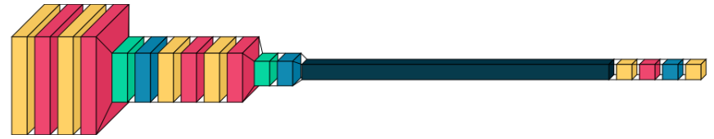
Base Model Structure
Our Neural Network Model process can be explained as above
32 - 32 - 64 -64
Pengru Lyu
Notes:
Two Convolutional layers with 32 filters of size 3x3, Two Convolutional layers with 64 filters of size 3x3, we have ReLU as our activation function

Slide 10
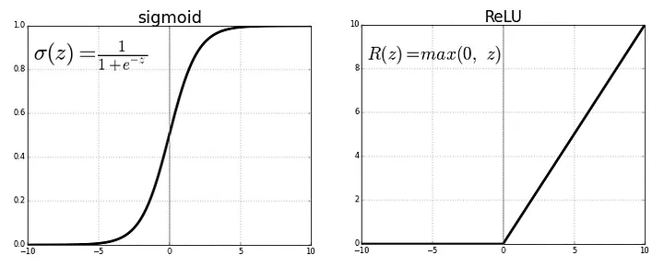
Activation Function Selection: Sigmoid VS ReLU
Figure: Sigmoid vs. ReLU
Source: https://miro.medium.com/v2/resize:fit:720/format:webp/1*XxxiA0jJvPrHEJHD4z893g.png
Pengru Lyu

Slide 11
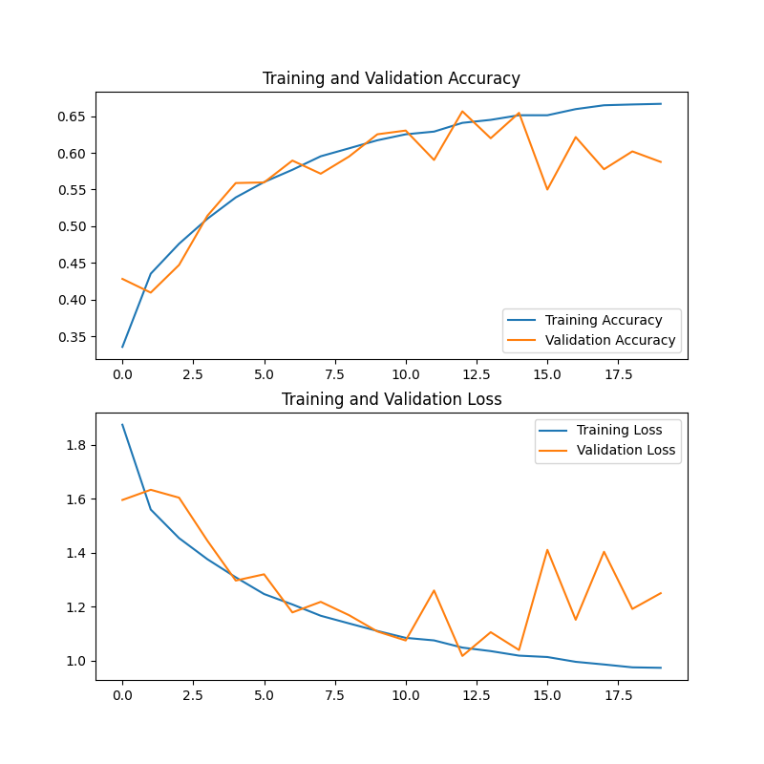
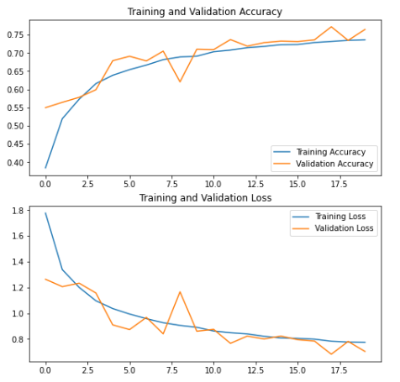
Sigmoid vs. ReLU
Figure: Sigmoid
Sigmoid Accuracy: 0.5877 (approx.)
Figure: ReLU, accuracy: 0.7533 (approx.)
Pengru Lyu
Notes:
From this part

Slide 12


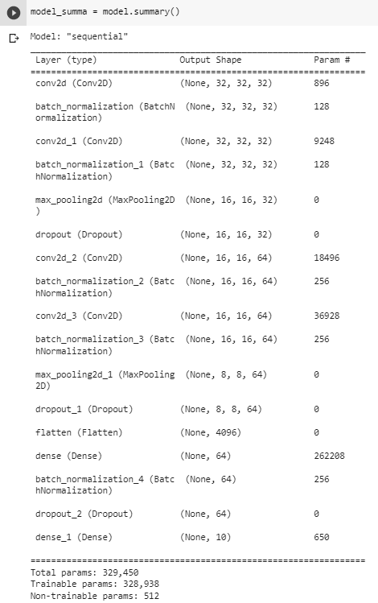
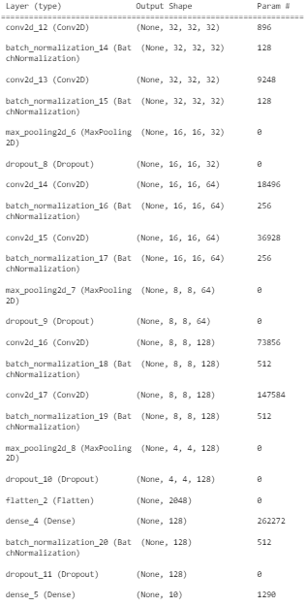
First Attempt: Add More Convolutional Layers
32-64-128
Xiao Ma

Slide 13

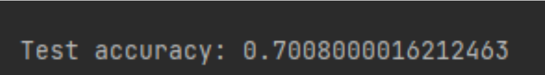
Second Attempt: Transfer Learning
Introduction: Taking a pre-trained neural network and adapting it to a new task
Popular models: GoogLeNet network, ImageNet
Results:
Xiao Ma
Notes:
Transfer learning is a popular technique in deep learning that involves taking a pre-trained neural network and adapting it to a new task. The idea behind transfer learning is that a pre-trained neural network has already learned to recognize features in data that are likely to be relevant for a wide range of tasks, so it can be fine-tuned for a new task with relatively little data.
To use transfer learning, you typically start by taking a pre-trained neural network that was trained on a large dataset, such as ImageNet for image recognition. You then remove the last few layers of the network, which are usually responsible for making predictions based on the features learned in the earlier layers. You replace these layers with new layers that are specific to your new task, such as recognizing different types of objects within images.
By using transfer learning, you can often achieve much better results with less data and training time than if you were to train a neural network from scratch. This is because the pre-trained network has already learned a lot of relevant features, and you only need to fine-tune it to your specific task.

Slide 14
Third Attempt: Learning Schedule and Regularization
Learning Schedule: Also known as learning rate schedule or learning rate decay, involves adjusting the learning rate during training
lr_schedule = tf.keras.optimizers.schedules.ExponentialDecay(
initial_learning_rate,
decay_steps=train_images.shape[0] // batch_size,
decay_rate=0.95,
staircase=True)
Regularization: Adding additional constraints to the training process to prevent overfitting
Method: Dropout
layers.Conv2D(64, (3, 3), activation='relu', padding='same', kernel_regularizer=l2_reg),
layers.BatchNormalization(),
layers.MaxPooling2D((2, 2)),
layers.Dropout(0.5),
Xiao Ma
Notes:
Learning schedule, also known as learning rate schedule or learning rate decay, involves adjusting the learning rate during training. The learning rate determines the step size of the updates made to the neural network weights during training. If the learning rate is too high, the updates can cause the weights to oscillate and prevent the network from converging to a good solution. If the learning rate is too low, the network may converge too slowly or get stuck in a local minimum. A learning schedule adjusts the learning rate over time to strike a balance between fast convergence and stable optimization.
Regularization, on the other hand, involves adding additional constraints to the training process to prevent overfitting. Overfitting occurs when a neural network learns to fit the training data too closely, resulting in poor generalization to new, unseen data. Regularization techniques, such as L1 and L2 regularization, dropout, and data augmentation, introduce constraints that encourage the network to learn simpler, more generalizable representations of the data.
Overall, learning schedule and regularization are both important techniques to consider when training neural networks to ensure good performance and generalization to new data.

Slide 15
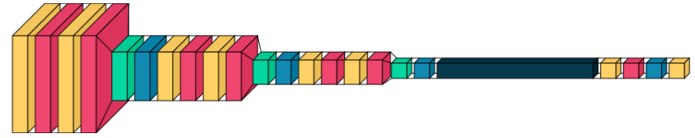
Final Model Structure
Wenxuan Gu
Notes:
This is the structure of our final model, we can see that we add the 128 filters layer after the 64 layers which is our base model because we found that the model was not overfitting when we were running the base model.
Also we used schedule learning and regularization described in the last slide to improve the performance and make our model more stable.
We did not use the transfer learning because we tests several pre-trained dataset like googlenet imagenet and resnet, they all didnt perform better than the base model.

Slide 16
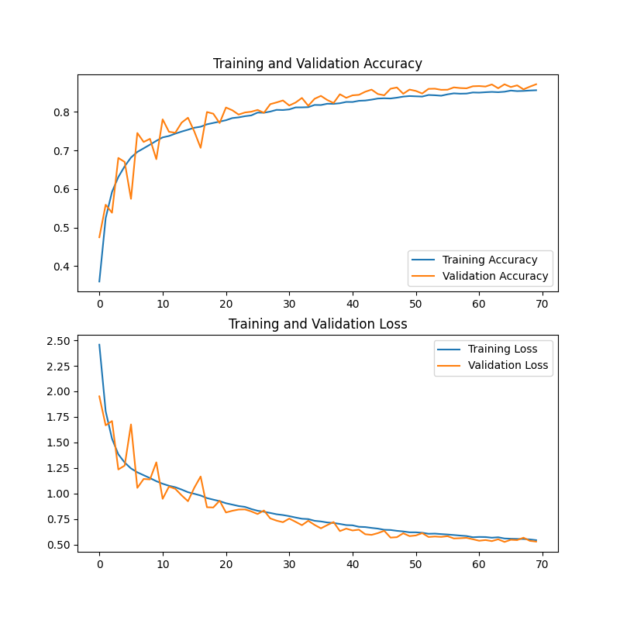
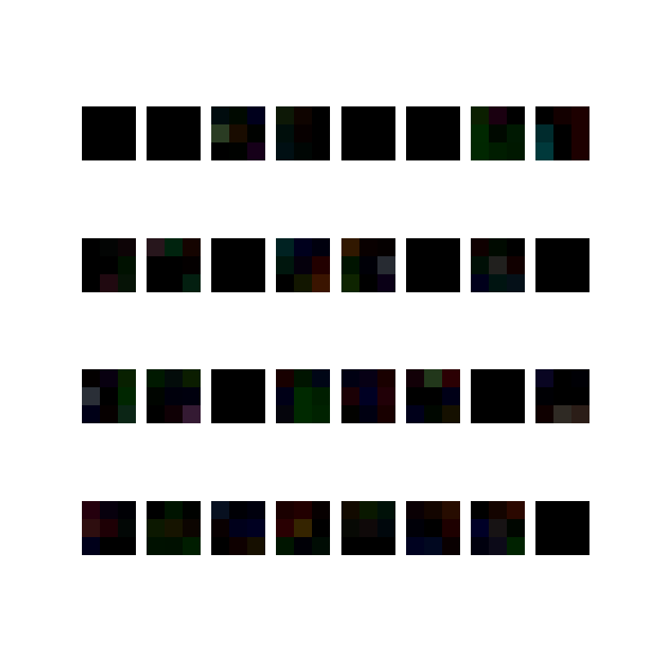
Final Model Accuracy
Accuracy: 0.8715999722480774
Wenxuan Gu
Notes:
And, this is the accuracy of our final model. It reaches .87.
We ran the model for 70 epochs, you can see that the validation line and training line matched well.
On the right side we randomly chose several images to perform the heat map. After 70 epochs training, we noticed that the accuracy is still increasing slowly. I think this model can reach accuracy near .90 at 100 epochs.

Slide 17
Way to Find the Maximum Epochs Needed
1. Pseudocode:
Epoch = 1000
Run model
Count == 0
While {
Track every accuracy outputted by Model
If ( Accuracy_{i} - Accuracy_{i-1} <= N )
Count += 1
If (count == 3)
Terminate model
Break}
2. Example:
Wenxuan Gu
Notes:
Here, we suggest one way to find the largest accuracy this model can reach.
Explain example and pseudo code
We didnt do that because this way requires large computing unit. Like the final CNN model we used, we need 6 to 7 hours to get the test result.

Slide 18
Convolutional SVM
We used CNN as a socket for SVM, and the flowchart would be shown as below:
Class 1
Input
Class 2
SVM
Class 3
Feature extraction layer
Class n
CNN Flowchart:
Class 1
Input
Class 2
Class 3
Feature Learning
Class n
1 Epoch training convolution connect to SVM
CNN accuracy:0.4151
Convolutional SVM accuracy:0.5797
Classification
Wenxuan Gu
Notes:
When we are improving our neural network, we also came up a way to improve other algorithms like SVM and KNN.
You can see that CNN model contains the classification part. We cut it at dense layer and use the convolution as feature for SVM.
The result is great. 1 epoch training CNN combined with SVM can reach .58 accuracy. If we use a complete training model like our final model, i think the accuracy can reach higher.

Slide 19
Conlusion
Performance (SVM vs. CNN)
Why ? (SVM suited for simpler datasets with fewer dimensions, CNN works better for image recognition task)
Yefan Li
Notes:
Here, I will make a comparison between the CNN and SVM classifier. Obviously, we can see that CNN performs better on the image classification problem.
Firstly, they are both suitable for classification problems. But, the important reason why CNN achieves a higher accuracy is that CNN can effectively extract the features from the image tasks. Based on the principle of SVM, it maps the input data to some high-dimensional space and tries to find the differences. This will cause low efficiency while processing the image task.
If we focus on the dataset CIFAR-10 in our project, CNN is very suitable for processing quite large and complex datasets like CIFAR-10 because it requires a large dataset to train the whole network. On the other hand, SVM can be trained on a smaller dataset and it performs better on low-dimensional problems.
Why: While SVM is a powerful machine learning algorithm, it is better suited for simpler datasets with fewer dimensions. On the other hand, CNN is a deep learning algorithm that is designed for image recognition tasks, making it an ideal approach for the CIFAR dataset. Our results demonstrate that CNN is a superior method for approaching the CIFAR dataset, and it is likely to be the preferred method for other similar image recognition tasks.

Slide 20
Thanks!
Do you have any questions?

